Slide 1
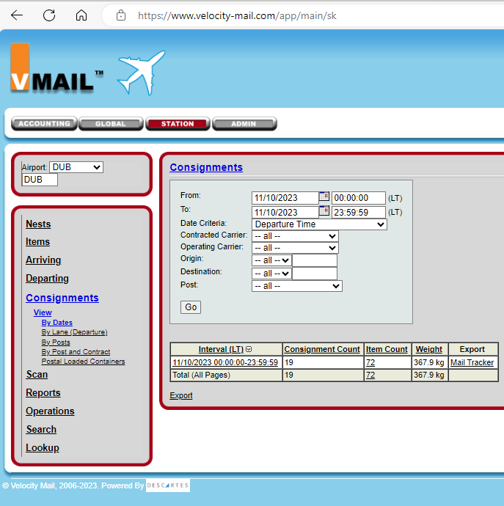
On station, choose “Consignment”
On station, choose “Consignment”

Slide 2
Click on item count

Slide 3
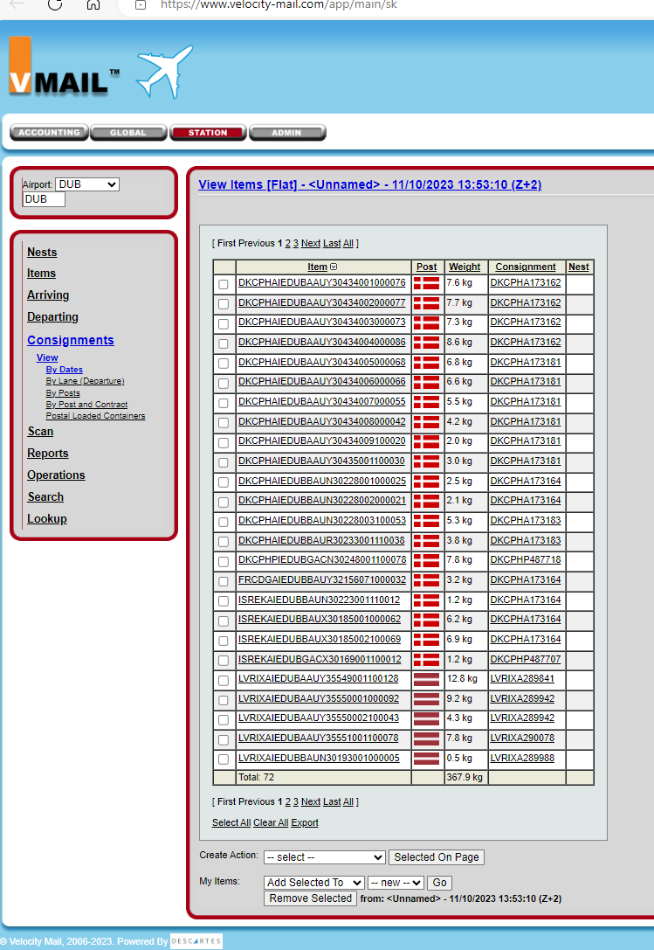
Select the desired items to deliver
Open “all” to see all on list

Slide 4
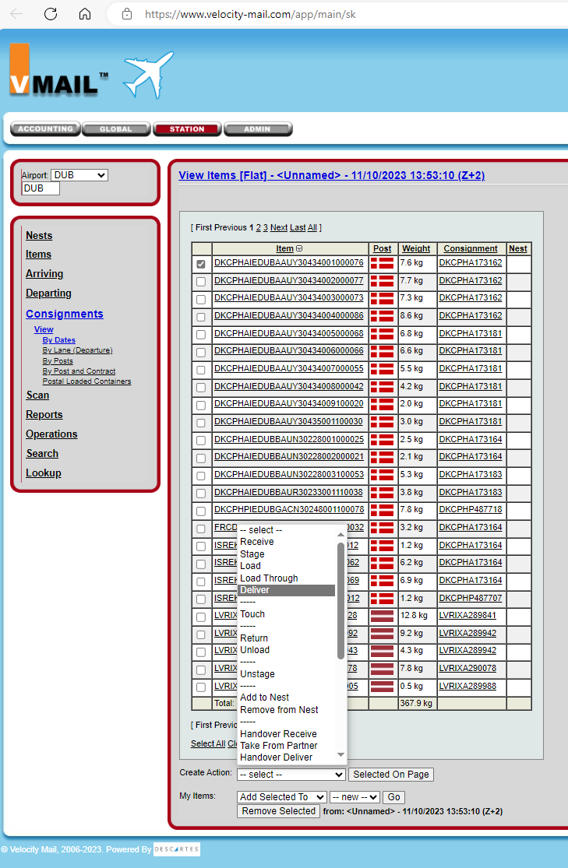
Selected
Drop down arrow to find “delivery”
Drop down arrow to find “deliver”
Then press “selected on page”
Drop down arrow to find “deliver”
Then press “selected on page”

Slide 5
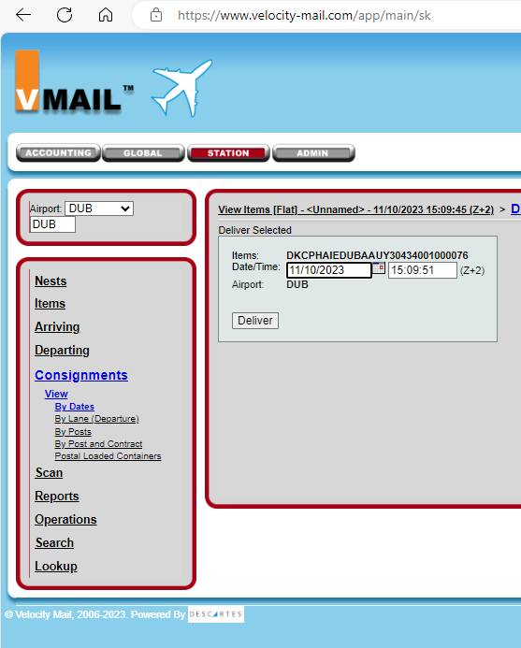
Date & Time must be accurate (check your GMT times = Z+X or Z-X)
Deliver

